Slide 1
Digital Portfolio
STUDENT NAME: Aswinthraj.A
REGISTER NO AND NMID: 222403553 and asunm285222403553
DEPARTMENT: B.Sc(CS)
COLLEGE: Sri Devi Arts and sincere College/ UNIVERSITY OF MADRAS
Notes:
Hyjk

Slide 2
PROJECT TITLE
GAME LOGIN PAGE

Slide 3


AGENDA
Problem Statement
Project Overview
End Users
Tools and Technologies
Portfolio design and Layout
Features and Functionality
Results and Screenshots
Conclusion
Github Link
3/21/2024 Annual Review

Slide 4

PROBLEM STATEMENT
The objective of this program is to design and implement a Game Login Page that allows users to securely access the game. The login page should include input fields for a username/email and password, along with a login button. The system should validate user credentials and provide appropriate feedback, such as successful login messages or error messages for incorrect inputs. Additional features may include sign-up, forgot password, and remember me options to enhance user experience.

Slide 5

PROJECT OVERVIEW
Project Overview: Game Login Page The Game Login Page is designed as the entry point for players to securely access the gaming platform. It provides a user-friendly interface where players can register, log in, and manage their accounts. The main objective is to ensure secure authentication while keeping the process simple and engaging for users.

Slide 6

WHO ARE THE END USERS?
The end users of a game login page are the people who directly interact with it. They include: 1. Players/Gamers – The main end users who log in to access the game, save progress, and enjoy personalized features. 2. New Users/Registrants – People signing up for the first time to create an account before playing. 3. Returning Users – Existing players who use the login page regularly to continue their gameplay. 4. Administrators/Testers (secondary users) – Sometimes developers, testers, or admins also use the login page to check functionality and security.

Slide 7

TOOLS AND TECHNIQUES
Tools HTML, CSS, JavaScript → For design and interaction. Database (MySQL / Firebase) → To store user login details. Authentication tools (JWT, Oauth, Firebase Auth) → For secure login. Techniques Form validation → Check username & password format. Password hashing → Keep credentials safe. Responsive design → Work on mobile & desktop. Session/token management → Keep players logged in.

Slide 8
POTFOLIO DESIGN AND LAYOUT
Prominent Imagery: Use high-quality images or carousels as a focal point on the homepage and key sections to display top sales, product launches, or mall events. Bold Colors and Fonts: Build layouts around theme colors and bold headings to make key areas—such as sales, promotions, or new arrivals—stand out. Intuitive Navigation: Implement clear menus, easy-to-find search bars, and category filters for simple browsing of stores, products, and services.
8

Slide 9
FEATURES AND FUNCTIONALITY
1. Basic Login Options Username/Email & Password fields. Sign Up option for new players. Forgot Password and Remember Me functions. 2. Advanced Login Methods Social login through Google, Facebook, Xbox, Steam, etc. Guest login to try the game without creating an account. Two-factor authentication and CAPTCHA for extra security. 3. Game-Specific Functions Load player profile, achievements, and saved game progress. Cross-platform sync (PC, mobile, console). Session management to avoid unauthorized access
4. User Experience Enhancements Attractive game-themed UI design with animations. Smooth transitions into the main game/lobby. Multi-language support and

Slide 10
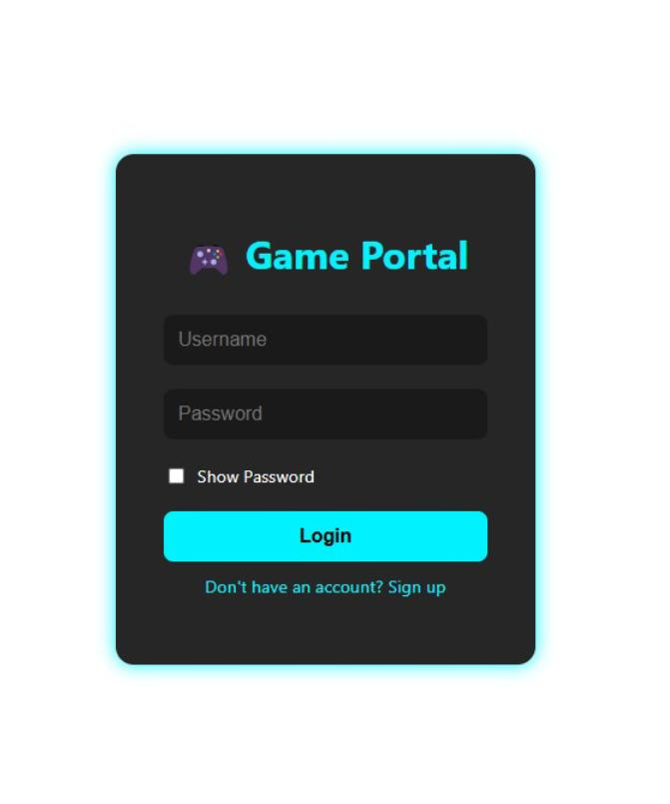

RESULTS AND SCREENSHOTS
The provided code bundle includes two separate HTML pages styled and scripted for a front-end e-commerce platform “Facebook Login Page”
3/21/2024 Annual Review
10

Slide 11
CONCLUSION
The Game Login Page serves as a secure and user-friendly gateway for players to access the game. It ensures safe authentication, protects user data, and provides a smooth entry point to enhance the overall gaming experience. By combining functionality with ease of use, the login page plays a crucial role in maintaining both security and convenience for end users.
11

Slide 12
GitHub Link
https://github.com/Aswinthraj24103/aswinth24103.git

